Slide 1
CSS3

Slide 2
Goal
Build better layouts with CSS3

Slide 3
Agenda
New Features
Box-shadow
Gradients
Borders, Border-Radius
Transformaties
Media Queries
Flexbox

Slide 4
Like HTML , CSS is a family of modules
5
3

Slide 5
Borders
Backgrounds
Colors
Text-effects
Box-sizing
Selectors
Transitions
Media Queries
Multi-column layout
Border-radius
Box-shadow
…

Slide 6
Like HTML , CSS is a family of modules
5
3

Slide 7
Versions aren’t used
Like HTML , CSS is a family of modules

Slide 8
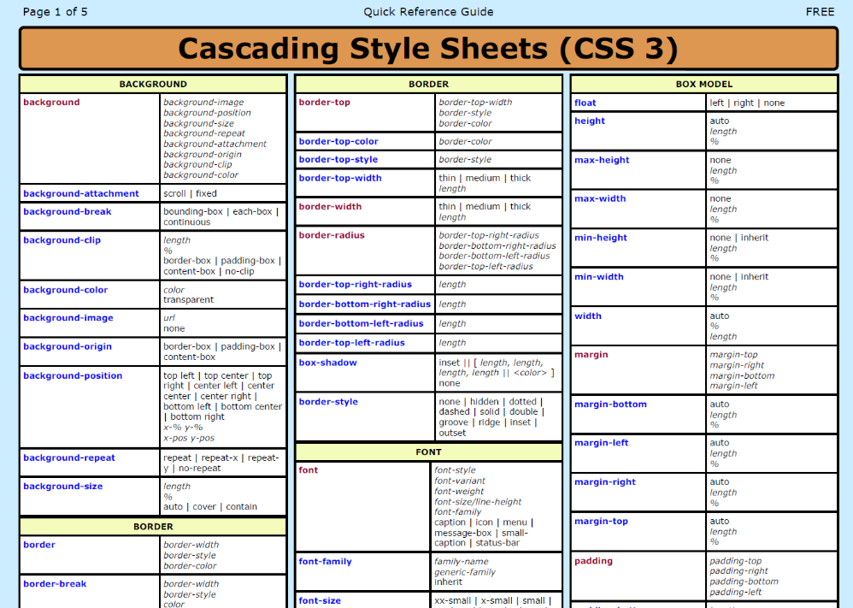

Slide 9
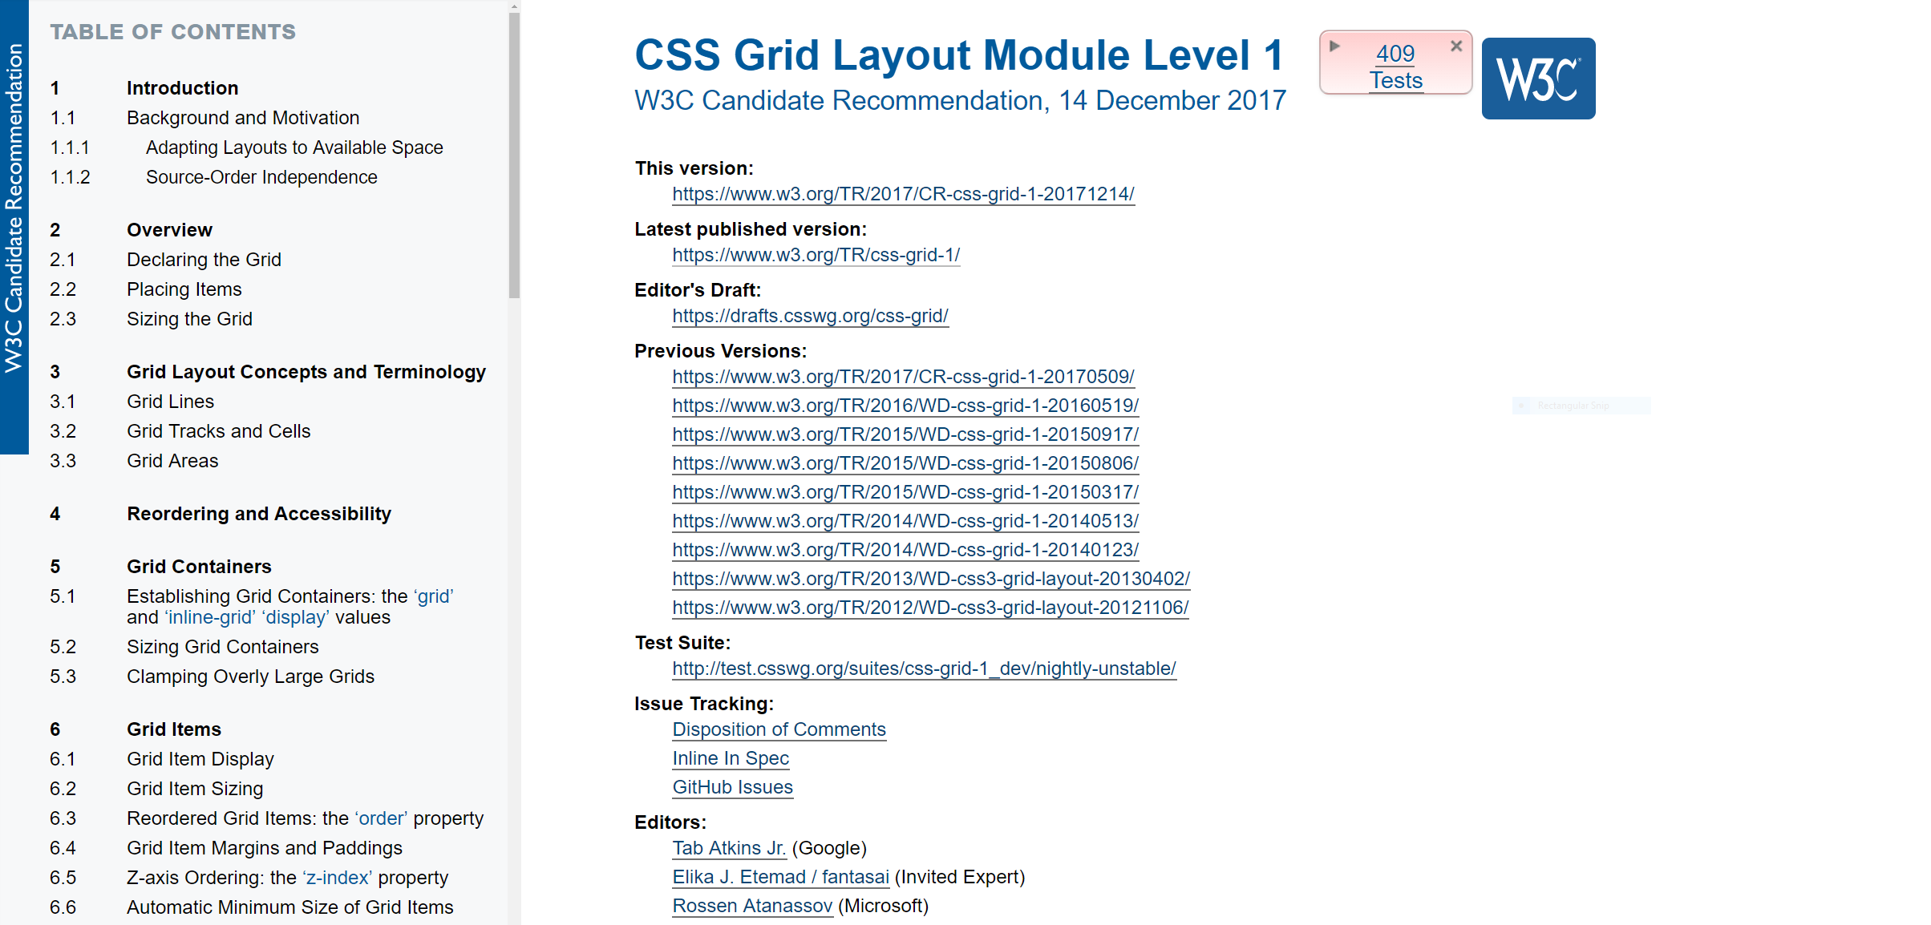

Slide 11
https://www.w3.org/Style/CSS/current-work.en.html

Slide 12
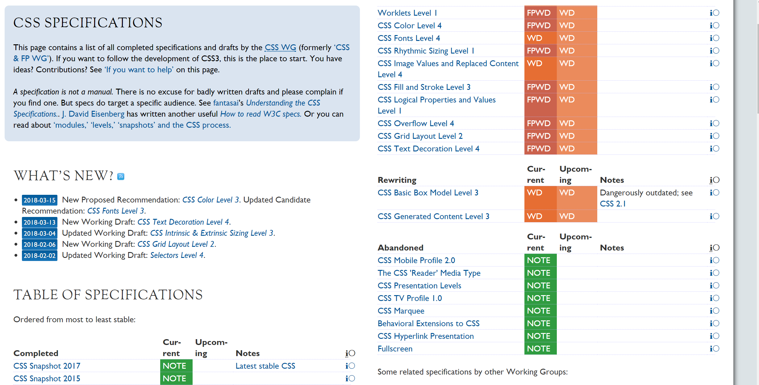

Slide 13
CSS3
Box-shadow

Slide 14

Box shadow
As the title says, adds shadow to an element
Use text-shadow for text elements

Slide 15
H-shadow
Blur
Color
box-shadow: 10px 10px 20px 1px #793b1c;
V-shadow
Spread

Slide 16
CSS3
Gradients

Slide 17
Gradients
Color-transition
Without the use of images
No extre HTTP requests
Used for UI effects
Round buttons
2 gradients available
Linear-gradient
Radial-gradient

Slide 18
Direction
Color Stop 2
background: linear-gradient(top, black 0%, white 100%);
Color Stop 1

Slide 19
CSS3
Border-radius

Slide 20
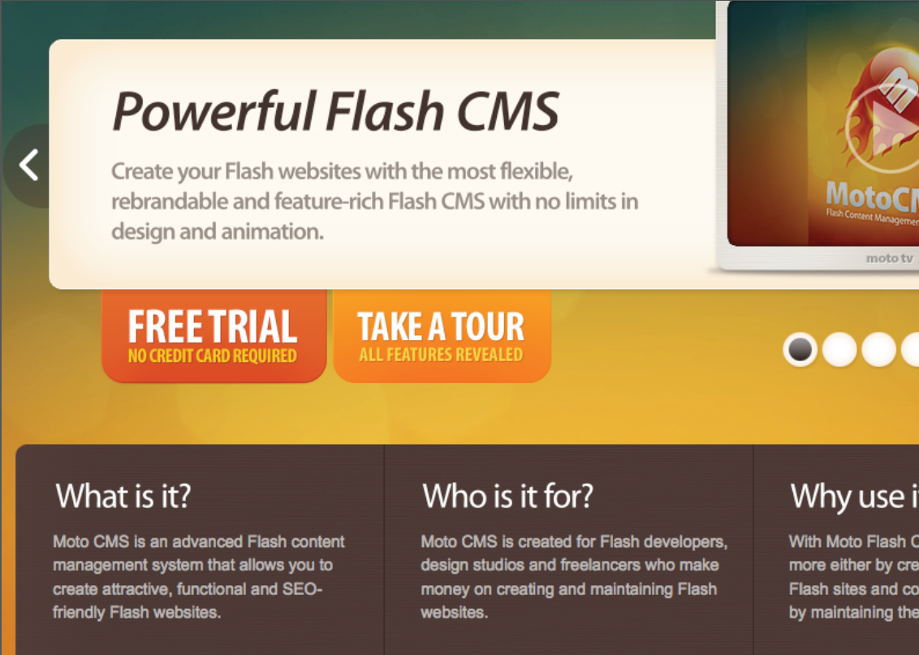

Slide 21
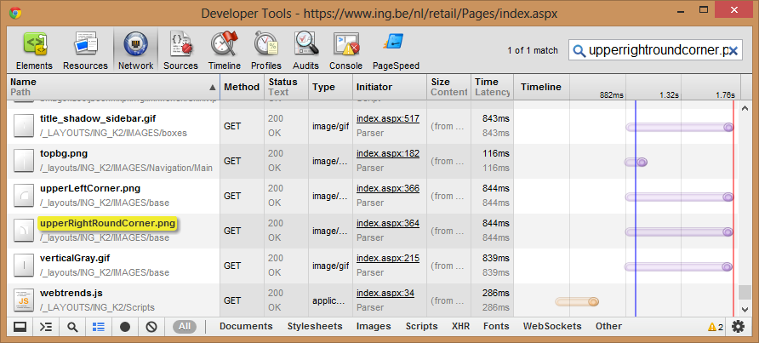
How we did it in the past
background: url("/upperRightRoundCorner.png") no-repeat 100% 0;

Slide 22
Avoid at all time
Extra http requests needed to download images

Slide 23


Slide 24

Border-radius
.rounded {
-webkit-border-radius: 20px;
-moz-border-radius: 20px;
border-radius: 20px;
}

Slide 25


Border-radius
80
80
border-top-left-radius: 80px;
60
80
border-top-left-radius: 80px 60px;

Slide 26

Border-radius
5
30
border-radius: 5px 30px 50px 80px;
80
50
border-radius: 5px 30px 50px 80px / 5px 30px 50px 80px;

Slide 27
CSS3
Transformations

Slide 28
Transformations
4 transformations available
Rotate
Translate
Skew
Scale
Can be combined

Slide 29
Rotate
-moz-transform: rotate(-25deg);
-ms-transform: rotate(-25deg);
-o-transform: rotate(-25deg);
-webkit-transform: rotate(-25deg);

Slide 30
Translate
.element
{
transform: translateX(value);
transform: translateY(value);
}
.element
{
transform: translate(translateX,translateY);
}

Slide 31
Skew
.element
{
transform: skewX(value);
transform: skewY(value);
}
.element
{
transform: skew(skewX,skewY);
}

Slide 32
Scale
.element
{
transform: scaleX(value);
transform: scaleY(value);
}
.element
{
transform: scale(scaleX,scaleY);
}

Slide 33
CSS3
Media Queries

Slide 34
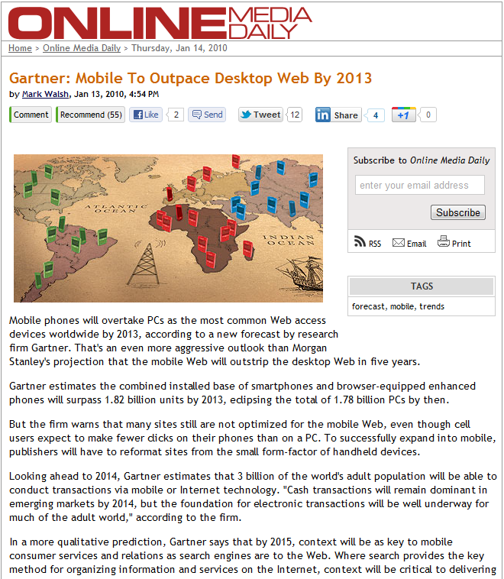

Slide 35
Responsive???

Slide 36
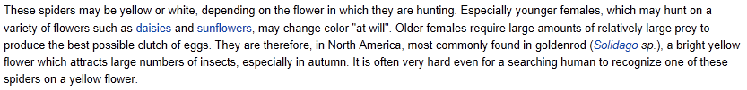
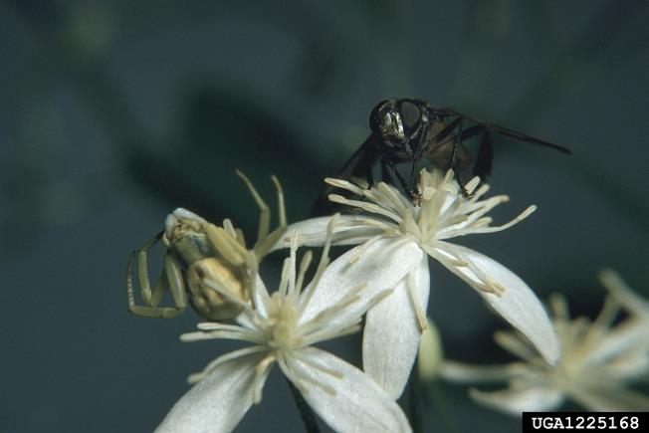

Slide 37


Slide 38


Slide 39
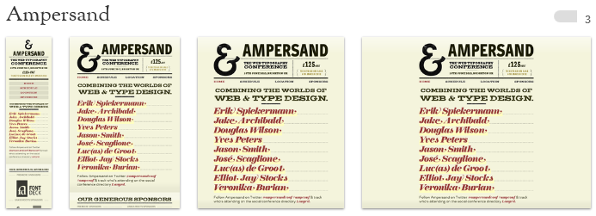

Slide 40
MEDIA QUERY
Type
Query of Expression
@media all and (max-width: 640px) {
}
Feature
Value

Slide 41
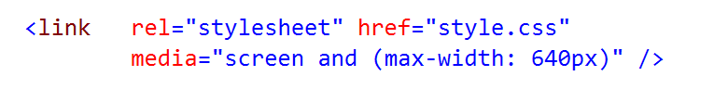
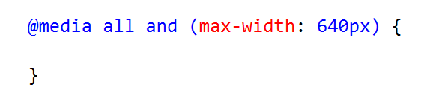
3 ways
1.
2.
3.

Slide 42
CSS3
Flexbox

Slide 43
Flexbox
The Flexbox Layout (Flexible Box) module aims at providing a more efficient way to lay out, align and distribute space among items in a container, even when their size is unknown and/or dynamic
Parent container with childs or flex-items
parent
flex-item
flex-item

Slide 44
Properties
display
flex-direction
flex-wrap
justify-content
align-items
align-content
flex-flow

Slide 45

Flex-direction
flex-direction: row |
row-reverse |
column |
column-reverse;

Slide 46
Flex-wrap
Flex items will, by default, try to fit onto one line
Change this behavior by using the flex-wrap property
Ideal for responsive design

Slide 47
Justify Content
Defines the alignment alond the main axis
Helps distribute extra free space left over when either all the flex items on a line are inflexible, or are flexible but have reached their maximum size.
It also exerts some control over the alignment of items when they overflow the line.

Slide 48
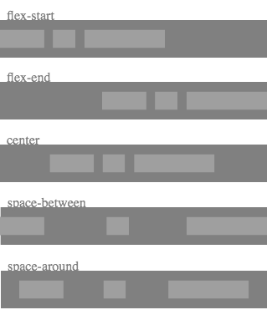
Justify Content

Slide 49
Align items
Defines the alignment along the cross axis.
Helps distribute extra free space left over when either all the flex items on a line are inflexible, or are flexible but have reached their maximum size.
Exerts some control over the alignment of items when they overflow the line.

Slide 50
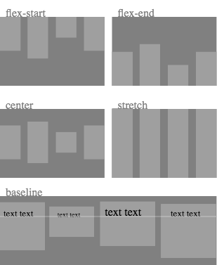
Align items

